Slide 1
Bitcoin Price Prediction Using an LSTM with COT Inputs
APS1052
Matan Winstok - 1001130199
Qianzhe Wang – 1003852789

Slide 2
Project Goals and Motivation
To determine if including new inputs can improve an LSTM's ability to predict the price of Bitcoin
Such inputs include:
Commitment of Traders (COT) inputs
Inputs based on Holt Winter's Exponential Smoothing forecast method
This project modifies and extends the multi-input LSTM provided in S10.Miscellaneous\LSTMBitcoin

Slide 3
Data
There are 2 data sources involved in this project, both of which are needed to be preprocessed prior to merging into a single dataset
1) Daily Bitcoin Data
Provided in btc_dataset.csv
Contains 17 columns (16 features and the target: "Closing Price")
Includes data between 2013/10/01 and 2020/10/09
Details regarding these features can be found in S10.Miscellaneous\LSTMBitcoin\Presentation.pptx
2) Weekly COT Data
The COT data for each year can be downloaded from the following link:
https://www.cftc.gov/files/dea/history/fut_fin_xls_YEAR.zip
Contain 84 columns for various assets but we only select a subset of these columns for Bitcoin
Includes data between 2018/04/10 and 2020/10/13

Slide 4
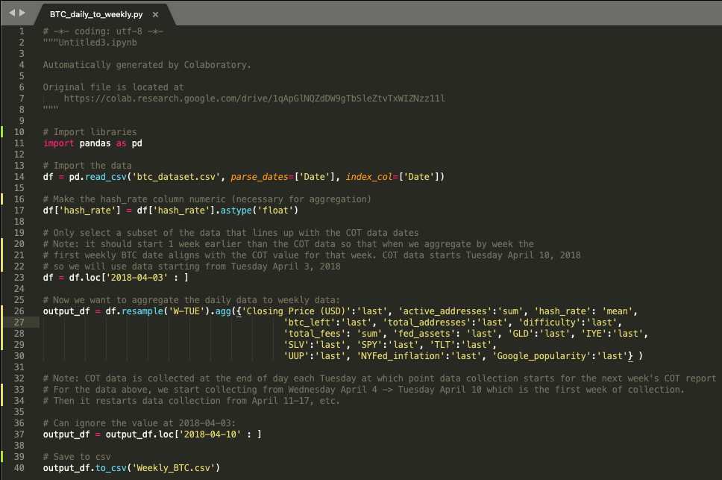
Daily Bitcoin Data
Since our two data sources have different frequencies we need to convert our daily bitcoin data to be on a weekly basis
This is done by running the "BTC_daily_to_weekly.py" script using btc_dataset.csv as input
Uses Pandas to aggregate each column to a weekly basis (week starts on a Tuesday in our case)
Outputs the weekly data in "Weekly_BTC.csv"

Slide 5
Weekly COT Data
Our COT data is found in 3 files:
2018.xls, 2019.xls, 2020.xls
We select a subset of columns that could be useful as Bitcoin predictors:
Pct_of_OI_Dealer_Long_All -- commercial hedger: % open interest long
Pct_of_OI_Dealer_Short_All --commercial hedger: % open interest short
Pct_of_OI_Lev_Money_Long_All --hedge fund speculator: % open interest long
Pct_of_OI_Lev_Money_Short_All --hedge fund speculator: % open interest short
We also calculate and use 2 other variables:
Percent change in net position for commercial hedgers: (Dealer_net_position_t - Dealer_net_position_t-1)/Dealer_net_position_t-1
Percent change in net position for hedge fund speculators: (Lev_Money_net_position_t - Lev_Moeny_net_position_t-1)/Lev_Money_net_position_t-1

Slide 6
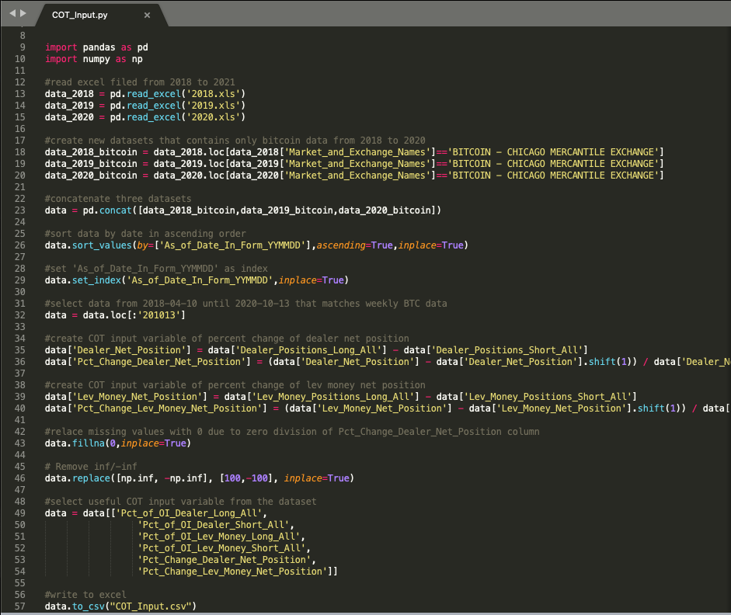
Weekly COT Data - Continued
The script "COT_Input.py" accepts as input the COT data (2018.xls, 2019.xls, 2020.xls) and outputs the weekly Bitcoin COT data to use in our model as "COT_Input.csv"
The script filters the assets to only include Bitcoin data
The script filters the dates to only include dates that match the weekly BTC data generated on Slide 4 ("Weekly_BTC.csv")
It also fills in missing values and inf/-inf values appropriately

Slide 7
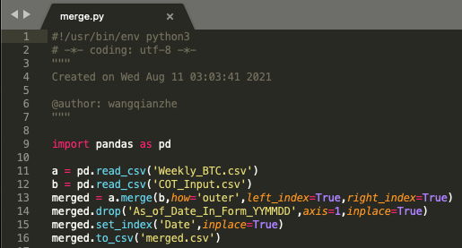
Merge Both Data Sources
We then combine both datasets into a single dataset using the "merged.py" script
Accepts as input:
Weekly_BTC.csv
COT_Input.csv
Outputs:
merged.csv

Slide 8
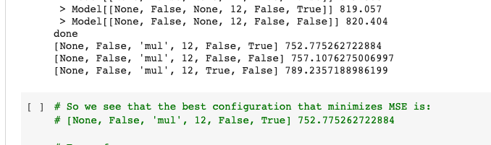
Holt Winter's Exponential Smoothing Inputs
Based on the code provided in:
S4.Miscellaneous\ExponentialSmoothingNotebooks\OptimizationInGeneral.ipynb
S4.Miscellaneous\ExponentialSmoothingNotebooks\PredictCarSales.ipynb
Our extension can be found in:
ai_in_finance_optimization_exponential_smoothing.ipynb
We use grid search to find the best configuration values that minimize the mean squared error (MSE)

Slide 9
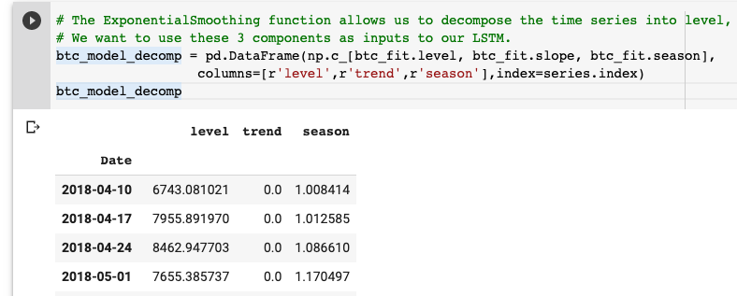
Holt Winter's Exponential Smoothing Inputs
We then instantiate a new ExponentialSmoothing model using the best set of configs and fit it to the data
The ExponentialSmoothing function allows us to decompose the time series into level, trend and seasonality components
We want to use these 3 components as inputs to our LSTM
We then combine these 3 columns with our dataset (merged.csv)
Script outputs the file as "merged_exponentialsmoothing.csv"
This csv file is now ready to be used as input into our LSTM model

Slide 10
Code Files
main.py is used to run the program and begin training the LSTM model
config.json is where all the settings are specified. Includes input filename, train-test split values, hyperparameters, etc.
detrend.py and WhiteRealityCheckFor1.py were included in order to evaluate the model's performance using White's Reality Check
The remaining files are helper functions required for main.py to run
Note: window normalization is used in dataloader.py
The venv (virtual environment) used for this project contained the following libraries:
Pandas
Tensorflow
Matplotlib
These libraries can be found in LSTMBitcoin_Code/requirements.txt
(On Mac) open terminal, cd to LSTMBitcoin_Code folder, and run the following commands:
python3 -m venv venv
. venv/bin/activate
pip3 install -r requirements.txt

Slide 11
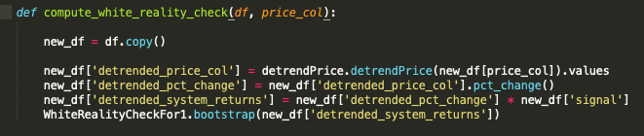
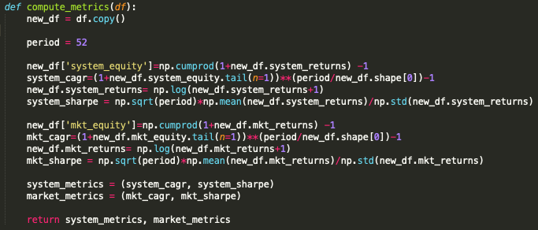
Utils.py
A new function was included in utils.py to compute White's Reality Check
Since our returns are now on a weekly basis we need to modify the compute_metrics() method to use a period of 52 instead of 252

Slide 12
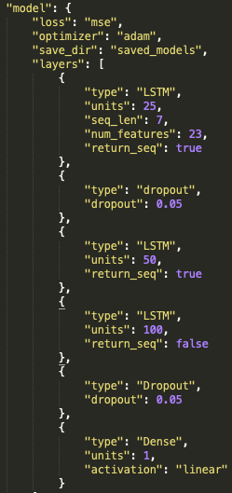
Model Architecture
The final model consists of four layers of neural net, first three layers being LSTM (number of neurons = 25, 50, 100 respectively), followed by a dense layer
Dropout layers are added at the input layer and the third LSTM layer with 0.05 dropout rate
Checkpoint_params, reduce_lr_params and early_stopping_params are all set to be validation loss to avoid overfitting

Slide 13
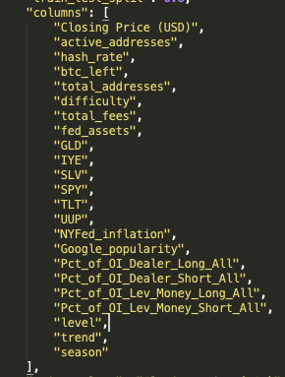
Model Configs Used
Epochs = 40, batch_size = 16, val_split = 0.2
Train_test_split = 0.8
Sequence_length = 7
Initial testing showed that the following two features degraded the LSTM's performance and were thus dropped:
Pct_Change_Dealer_Net_Position
Pct_Change_Lev_Money_Net_Position
Therefore 23 columns in total were used as specified in config.py

Slide 14
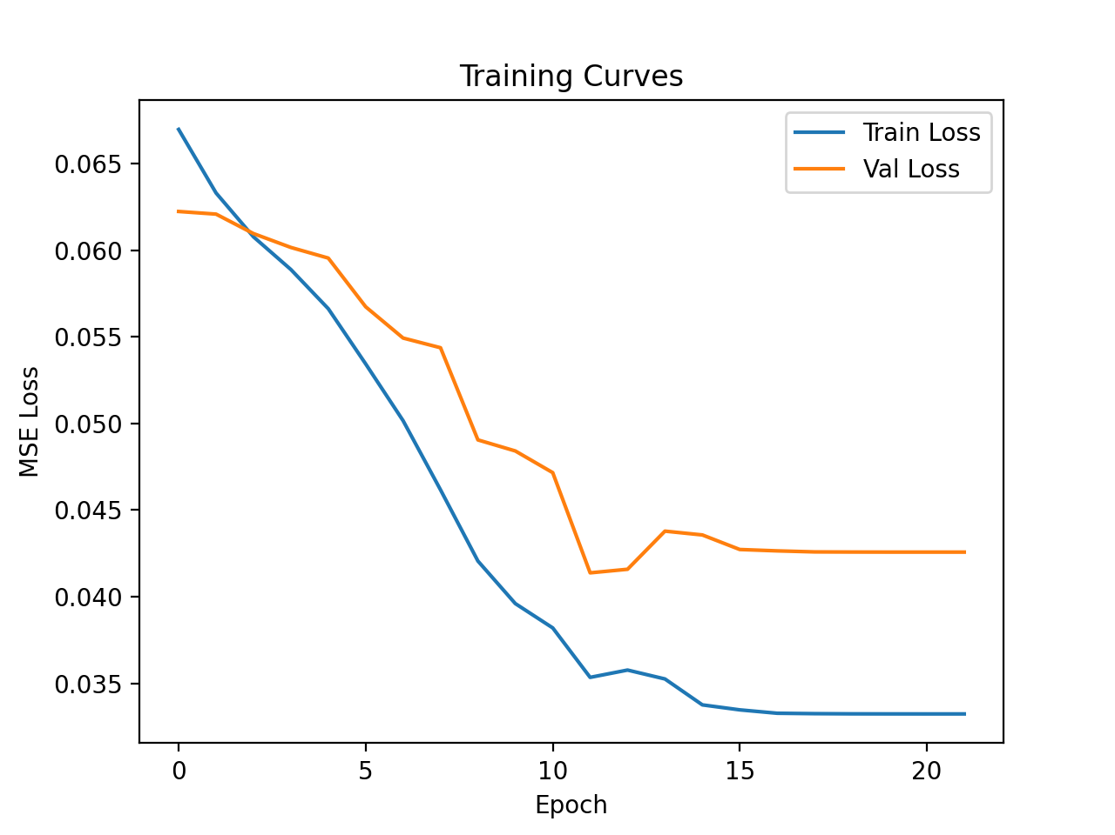
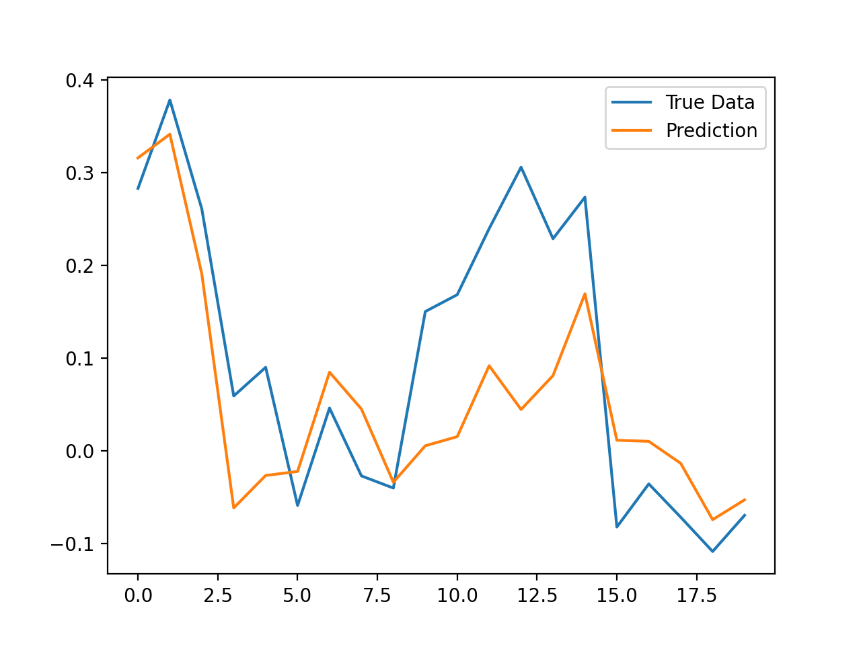
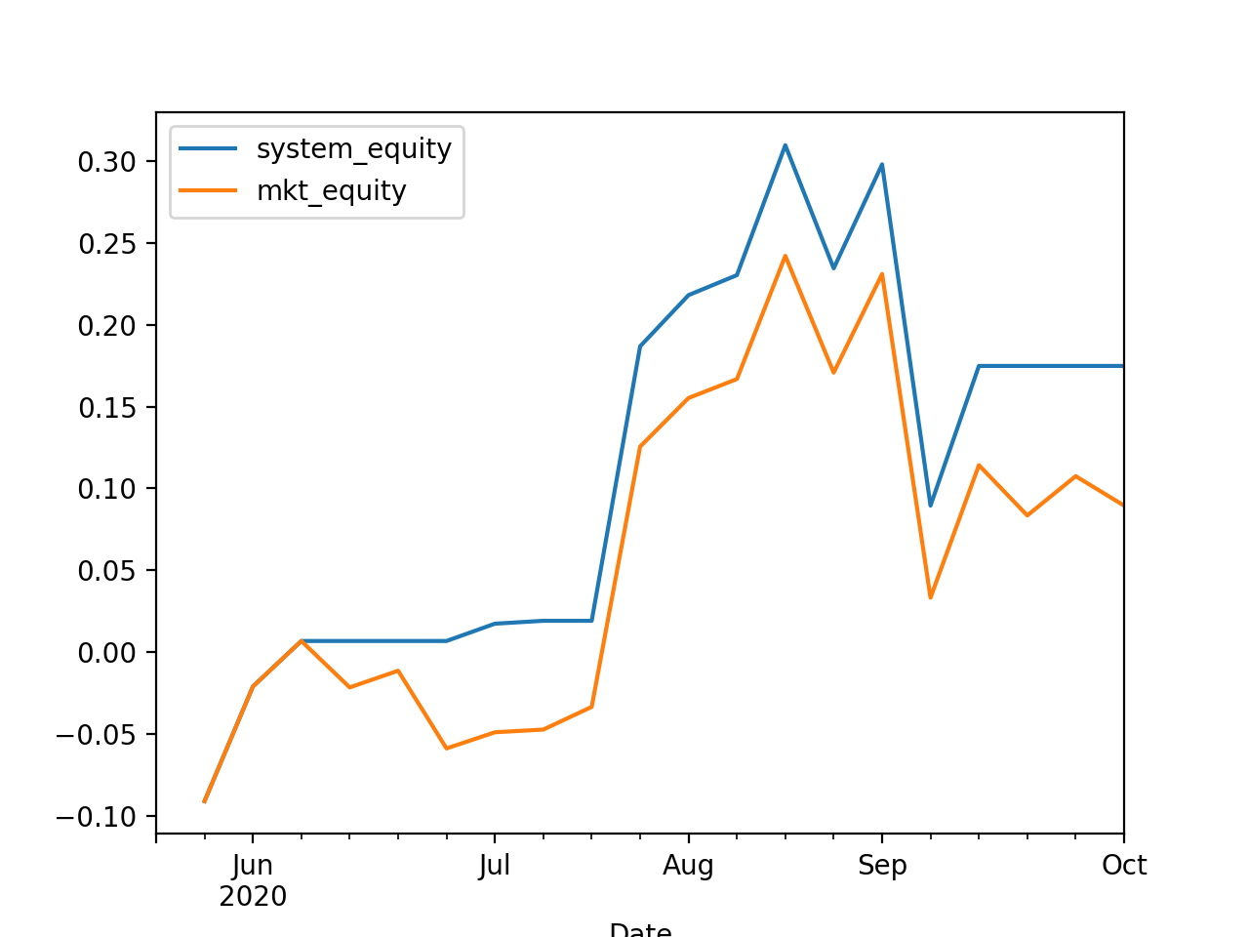
Results - Original BTC Features Only
Model was trained using the original 16 columns found in weekly BTC data without any additional inputs
Training and Testing Losses
Next Day Price Prediction
Change In Equity Over Time

Slide 15
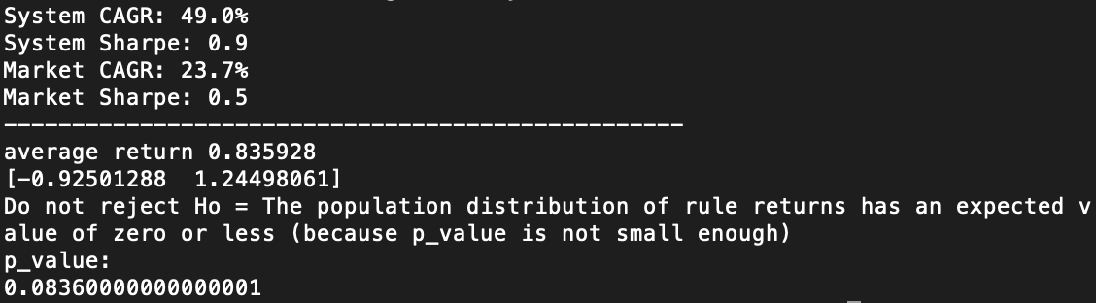
Results - Original BTC Features Only
The system equity curve is slightly above market equity curve
The system CAGR (49.0%) is way above market CAGR (23.7%) and the system Sharpe ratio (0.9) is also higher than market Sharpe (0.5)
The large p-value (0.0836) does not reject the null hypothesis that the expected return is zero or less

Slide 16
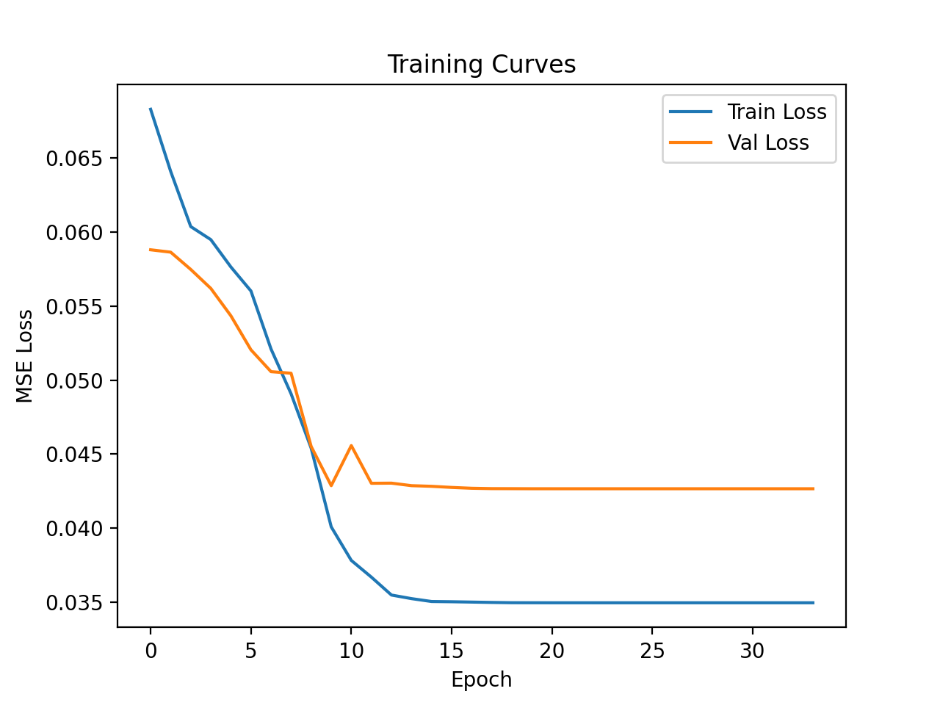
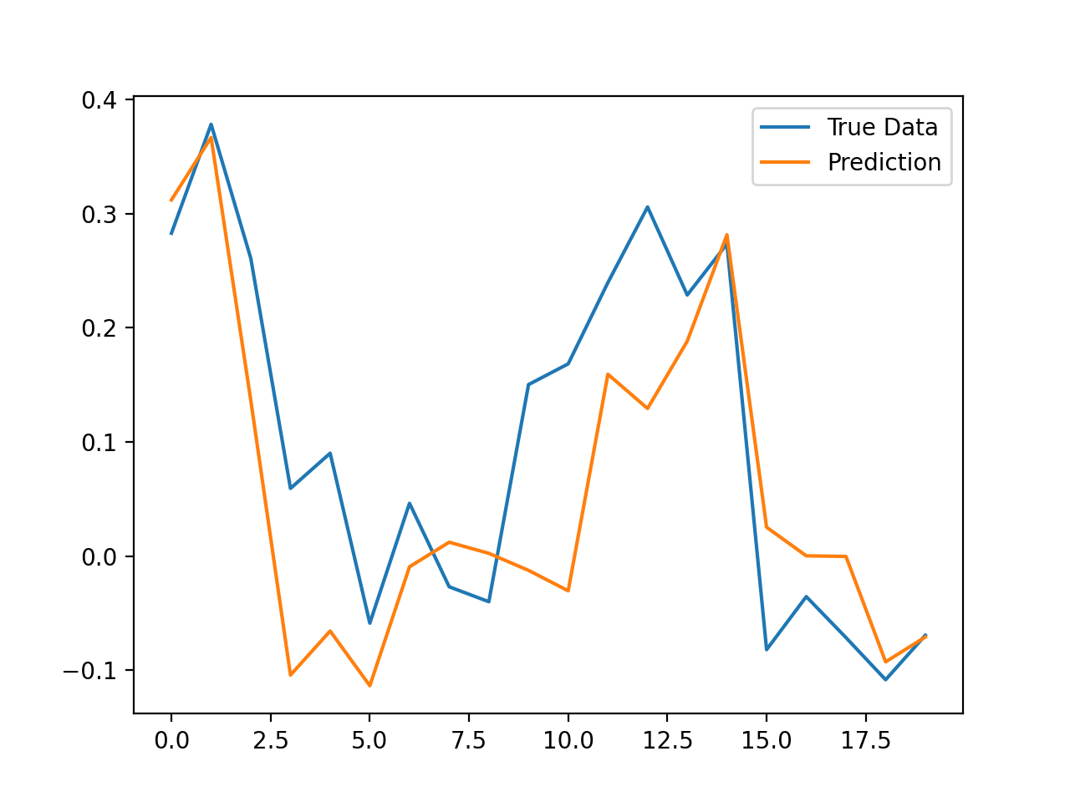
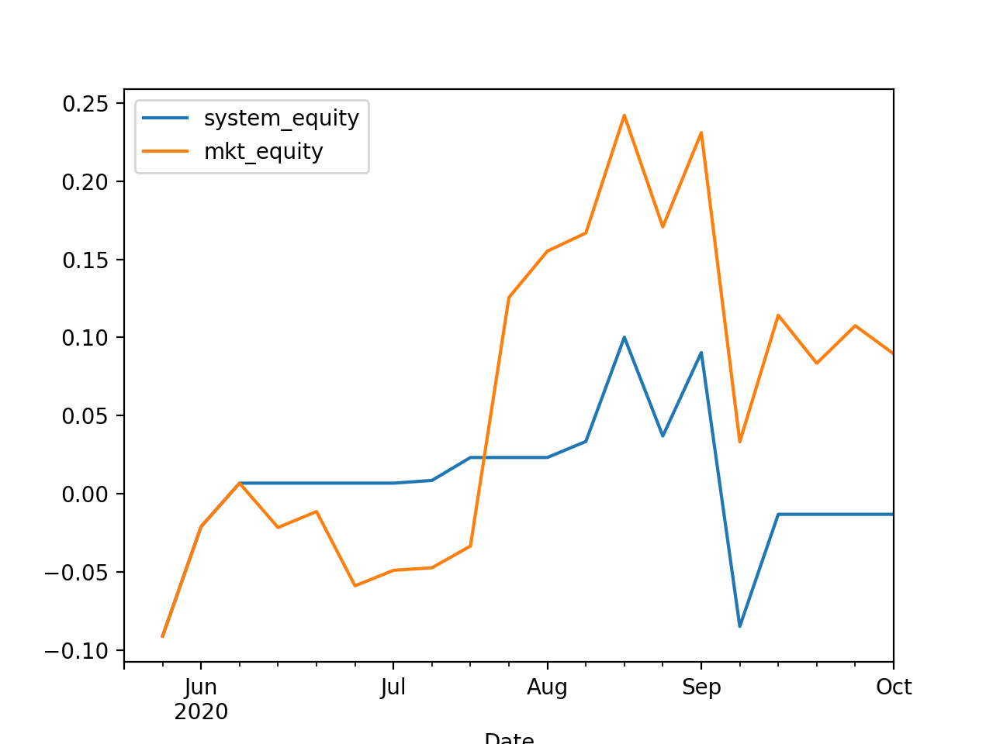
Results - Original BTC Features + COT Inputs
Model was trained using the original 16 columns found in weekly BTC data along with the 4 COT inputs for a total of 20 features
Training and Testing Losses
Next Day Price Prediction
Change In Equity Over Time

Slide 17
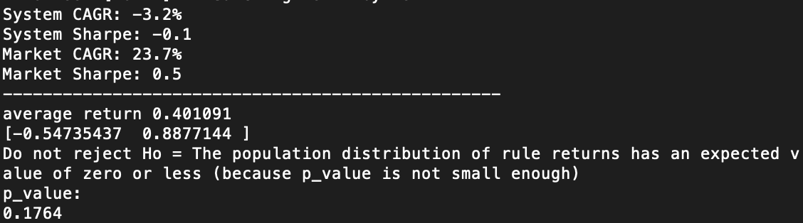
Results - Original BTC Features + COT Inputs
Flat training curves of both train and validation indicates potential underfitting of the model
System equity curve is below market equity which indicates the COT inputs are not helpful to improve model performance
Negative system CAGR and Sharpe indicates again that the COT inputs are not useful features
High p-value indicates that the null hypothesis that expected return is zero or less is not rejected

Slide 18
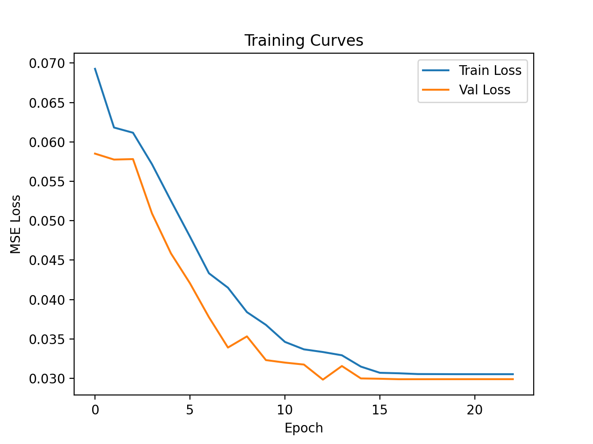
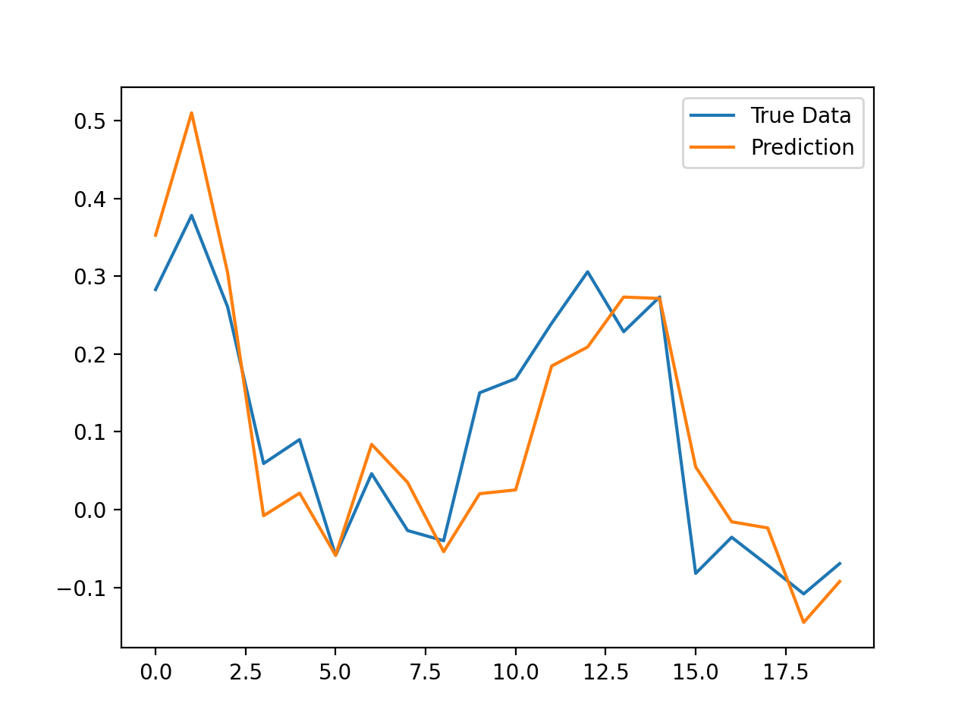
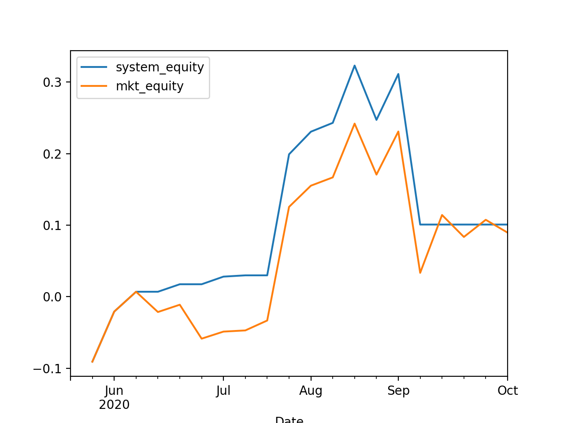
Results - Original BTC Features + Exponential Smoothing Inputs
Model was trained using the original 16 columns found in weekly BTC data along with the 3 Exponential Smoothing inputs for a total of 19 features
No COT inputs were used
Training and Testing Losses
Next Day Price Prediction
Change In Equity Over Time

Slide 19

Results - Original BTC Features + Exponential Smoothing Inputs
Strictly decreasing training curves indicate the best result among all cases
System curve is slightly above market curve
System CAGR is slightly greater than market CAGR
High p-value indicates that the null hypothesis that expected return is zero or less is not rejected

Slide 20
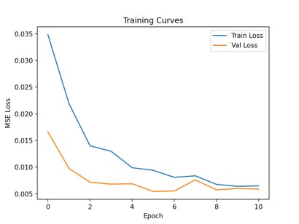
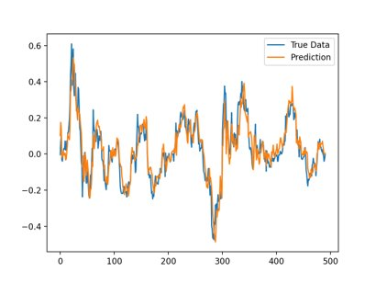
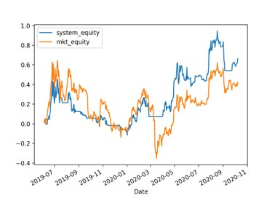

We lost a lot of useful data for two reasons: 1) we had to convert our daily BTC data to weekly to match the COT data and 2) we had to filter dates in our BTC data to match the limited subset of dates in the COT data
Looking at the # of records, we only have 5% of the data as compared to the original daily BTC data. This small amount of available data resulted in very inconsistent, poor model performance
To try and alleviate this, we repeated the steps in slide 8 and 9 but this time using the original daily BTC data (no COT data)
Seen in ai_in_finance_optimization_exponential_smoothing_EXTENDED.ipynb
Generated new dataset to use: btc_dataset_exponentialsmoothing.csv
We then used a model with the following configs and saw improved, much more consistent performance:
# of columns: 19 (16 original BTC columns + 3 exponential smoothing inputs)
Sequence length: 21
Period (in compute_metrics() in utils.py): 252
Remaining configs same as before

